Slide 1
Node.js
RESTful API - Server.js with Express.js

Slide 2
Back End Reality ☺
LET’S START

Slide 3
SOME IMPORTANT DEFINITIONS
API
HTTP
Node.js
Middleware functions
RESTful API

Slide 4
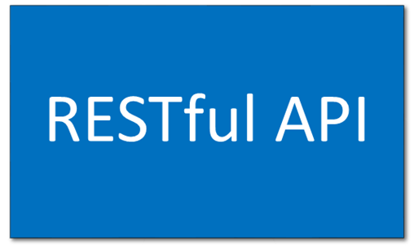


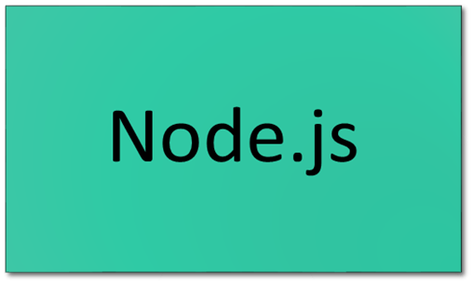

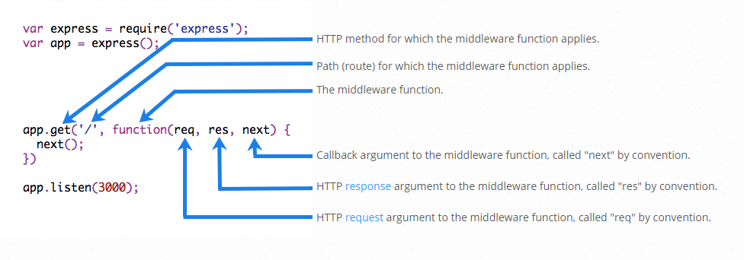
Revision
Provision
Middleware functions are functions that have access to the request object ( req ), the response object ( res ), and the next function in the application's request-response cycle. The next function is a function in the Express router which, when invoked, executes the middleware succeeding the current middleware.
RESTful API
A RESTful API is an application program interface (API) that uses HTTP requests to GET, PUT, POST and DELETE data.
HTTP (Hypertext Transfer Protocol) is the set of rules for transferring files (text, graphic images, sound, video, and other multimedia files) on the World Wide Web.
As soon as a Web user opens a Web browser, the user is indirectly making use of HTTP.
HTTP is an application protocol that runs on top of the TCP/IP suite of protocols (the foundation protocols for the Internet).
application program interface (API)
An application program interface (API) is a code that allows two software programs to communicate with each other.
Node.js (Node) is an open source development platform for executing JavaScript code server-side. Node is useful for developing applications that require a persistent connection from the browser to the server and is often used for real-time applications such as chat, news feeds and web push notifications.

Slide 5
Practical Exercise
Lets go to the Live Coding

